Slide 1
Class Average
Given marks secured in CSE1001 by the students in a class, design an algorithm and write a Python code to determine the class average. Print only two decimal digits in average

Slide 2
Class Average
Input | Processing | Output
Number of students in class, mark scored by each student | Determine total of marks secured by students Find average of marks | Class average of marks

Slide 3
Average marks scored by ‘N’ number of Students
Step 1: Start Step 2 : Read Number Of Students Step 3 : Initialize counter as 0 Step 4 : Input mark Step 5 : Add the mark with total Step 6 : Increment the counter by 1
Step 7: repeat Step 4 to Step 6 until counter less than number of students
Step 7: Divide the total by number of students and store it in average
Step 8: Display the average
Step 9: Stop

Slide 4
Test Cases
Input
5
90 85 70 50 60
Output
71.00
Processing Involved

Slide 5
Already Know
To read values from user
To check if a condition is satisfied
Print characters

Slide 6
Yet to learn
Repeatedly execute a set of statements

Slide 7
Need of iterative control
Repeated execution of set of statements
An iterative control statement is a control statement providing repeated execution of a set of instructions
Because of their repeated execution, iterative control structures are commonly referred to as “loops.”

Slide 8
While statement
Repeatedly executes a set of statements based on a provided Boolean expression (condition).
All iterative control needed in a program can be achieved by use of the while statement.

Slide 9
Syntax of While in Python
while test: # Loop test
statements # Loop body
else: # Optional else
statements
# Run if didn't exit loop with break

Slide 10
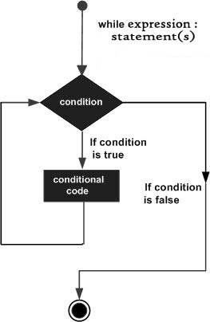
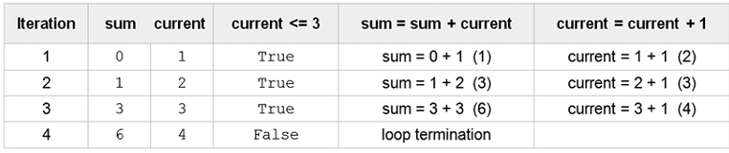
Example use
Sum of first ‘n’ numbers
sum =0
current =1
n=3
while current <= n:
sum=sum + current
current = current + 1

Slide 11
Print values from 0 to 9 in a line
a=0; b=10
while a < b: # One way to code counter loops print(a, end=' ')
a += 1 # Or, a = a + 1
Output:
0 1 2 3 4 5 6 7 8 9
Include end=‘ ‘ in print statement to suppress default move to new line

Slide 12
Break, continue, pass, and the Loop else
break Jumps out of the closest enclosing loop
continue Jumps to the top of the closest enclosing loop
pass Does nothing at all: it’s an empty statement placeholder
Loop else block Runs
if and only if the loop is exited normally (i.e., without hitting a break)

Slide 13
Break statement
while True:
name = input('Enter name:')
if name == 'stop': break
age = input('Enter age: ')
print('Hello', name, '=>', int(age) ** 2)
Output:
Enter name:bob
Enter age: 40
Hello bob => 1600

Slide 14
Pass statement
Infinite loop
while True: pass
# Type Ctrl-C to stop me!

Slide 15
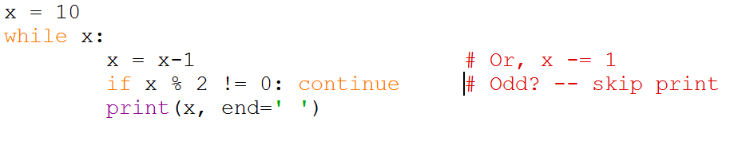
Print all even numbers less than 10 and greater than or equal to 0

Slide 16
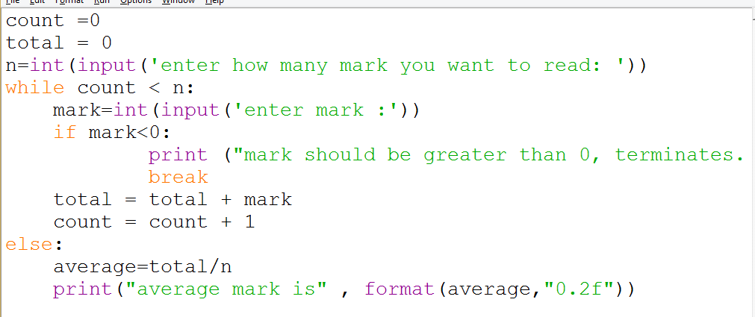
Class Average

Slide 17
Pattern Generation
Your teacher has given you the task to draw the structure of a staircase. Being an expert programmer, you decided to make a program for the same. You are given the height of the staircase. Given the height of the staircase, write a program to print a staircase as shown in the example. For example, Staircase of height 6:
#
##
###
####
#####
######
Boundary Conditions: height >0

Slide 18
Pattern Generation
Input | Processing | Output
Staircase height | Create steps one by one To create a step print character equal to length of step | Pattern

Slide 19
Pseudocode
READ staircase_height
if staircase_height > 0
x = 1
Repeat
y = 1
Repeat
print #
y = y + 1
Until y <= x
x = x + 1
Until x <= staircase_height
End if
Else
Print “Invalid input”

Slide 20
Test Cases
Input
3
Output
#
# #
# # #
Processing Involved
Print step by step

Slide 21
Test Cases
Input
-1
Output
Invalid input
Processing Involved
Boundary condition check fails

Slide 22
For iteration
In while loop, we cannot predict how many times the loop will repeat
The number of iterations depends on the input or until the conditional expression remains true

Slide 23
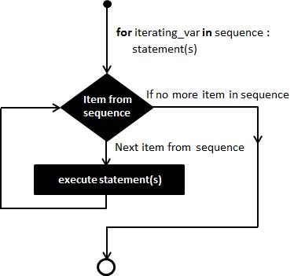
Control flow of for statement

Slide 24
Syntax of for Statement
for target in object:
# Assign object items to target
statements
if test: break # Exit loop now, skip else if test: continue # Go to top of loop now
else: statements # If we didn't hit a 'break’

Slide 25
For and Strings
for iterating_var in sequence or range:
statement(s)
Example:
for letter in 'Python':
print ('Current Letter :', letter)

Slide 26
For and Strings
When the above code is executed:
Current Letter : P
Current Letter : y
Current Letter : t
Current Letter : h
Current Letter : o
Current Letter : n

Slide 27
For and Range
for n in range(1, 6):
print(n)
When the above code is executed:
1
2
3
4
5

Slide 28
range function call
Syntax - range( begin,end,step )
where
Begin - first value in the range; if omitted, then default value is 0
end - one past the last value in the range; end value may not be omitted
Step - amount to increment or decrement; if this parameter is omitted, it defaults to 1 and counts up by ones
begin, end, and step must all be integer values;
floating-point values and other types are not allowed

Slide 29
Example for Range
range(10) → 0,1,2,3,4,5,6,7,8,9
range(1, 10) → 1,2,3,4,5,6,7,8,9
range(1, 10, 2) → 1,3,5,7,9
range(10, 0, -1) → 10,9,8,7,6,5,4,3,2,1
range(10, 0, -2) → 10,8,6,4,2
range(2, 11, 2) → 2,4,6,8,10
range(-5, 5) → −5,−4,−3,−2,−1,0,1,2,3,4
range(1, 2) → 1
range(1, 1) → (empty)
range(1, -1) → (empty)
range(1, -1, -1) → 1,0
range(0) → (empty)

Slide 30
Print Even Numbers Using Range
>>> for i in range(2,10,2):
print(i)
Output:
2
4
6
8

Slide 31
